Slide 1
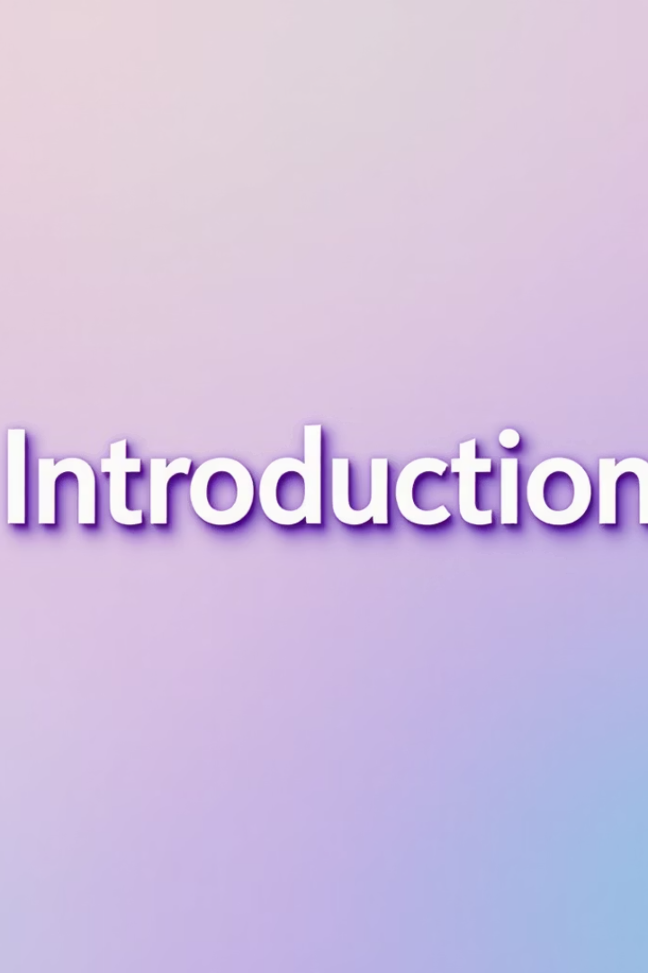
Maintenance Management System Project
This presentation details the design and demonstration of a maintenance management system.
We will cover system objectives, analysis, design, methodology, and application features.
Notes:
We are Group 4, and today, we will be introducing our Maintenance Management System Project.
Managing equipment by hand can be complicated and can cause delays in keeping track of maintenance. To solve this, we built an app that makes it easy and quick to record and follow up on maintenance tasks.
With this app, you have all the important information in one place. It helps save time, stay organized, and manage your equipment better.

Slide 2
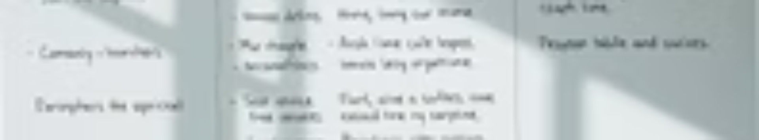
Presentation Plan Overview
1
Introduction
2
Analysis and Design
3
Demonstration
Presentation of the project context
General introduction to project and features
Showcase of the application functionality
Notes:
Let us start by giving you an overview of our presentation: We will begin with the context of the project, followed by the analysis and design process. Then, we will demonstrate the functionality of the system and conclude with a summary of the outcomes.

Slide 3
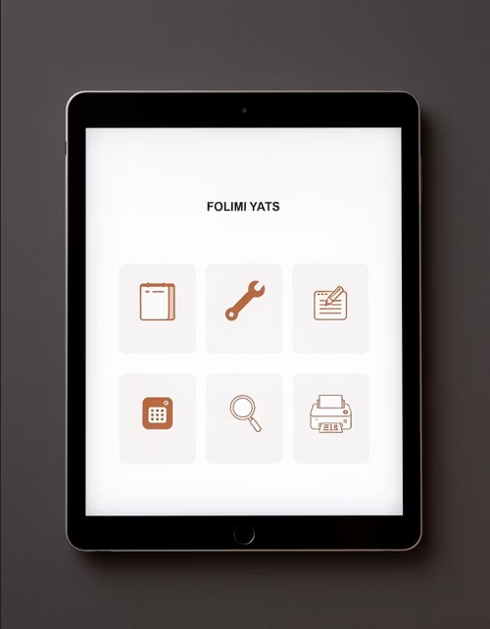
Project Description and Objectives
Facilitate the work of the maintenance agent by streamlining
processes and communication.
Primary Objective
Centralized data management
Comprehensive maintenance history tracking
PDF generation of maintenance records
Interactive dashboard for quick insights
Email notifications to technicians
Key Features
Notes:
This project aims to modernize and optimize the management of maintenance activities to make operations more efficient and reliable. To achieve this objective, the key features implemented are as follows:
Data management with operations such as adding, modifying, deleting, and searching;
Structured tracking through maintenance history and the ability to export this history in PDF format;
Facilitated communication with the sending of emails to the relevant technicians;
An interactive dashboard providing an overview of maintenance operations.

Slide 4
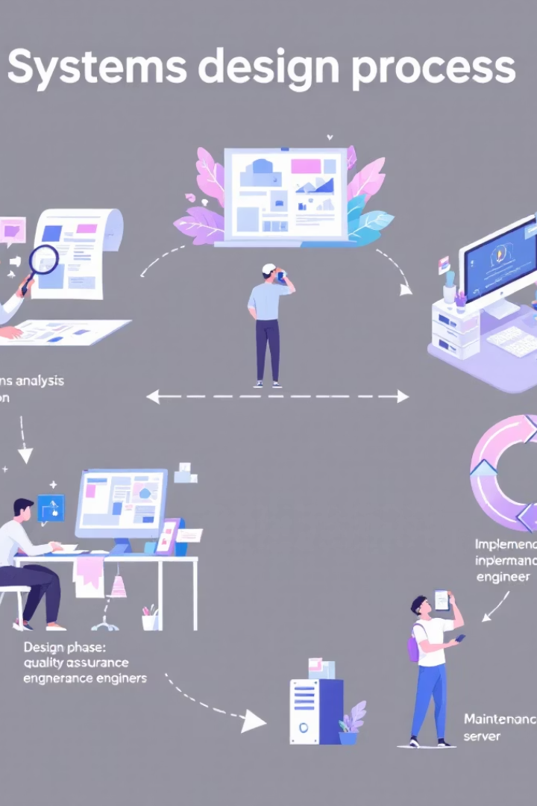
Analysis and Design Process
Existing System Study
Examined current maintenance workflows to identify inefficiencies.
Modeling
Created detailed data and process representations for clarity.
Proposed Solutions
Developed designs addressing identified problems and enhancing functionality.
Methodology & Tools
Selected suitable methodologies and technologies for development.
Notes:
Now that we have finished the presentations, let’s move on to Part II: Analysis and Design, a crucial step in the project development process.

Slide 5
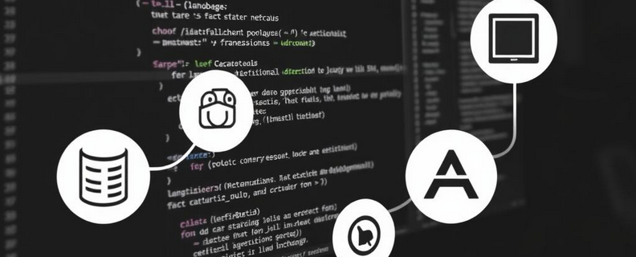




Methods and tools used
2TUP
UML
Notes:
The methods and tools utilized in this development are:
PostgreSQL: For data storage and management.
Visual Paradigm: A UML modeling tool for designing the application's architecture.
Django: A Python web framework for backend development.
Visual Studio Code: A code editor enabling efficient project management and development through its extensions.
2TUP: A design modeling method used for the application's process and flow diagrams.
UML: A standard modeling language used to design the structure and interactions of a software system.

Slide 6
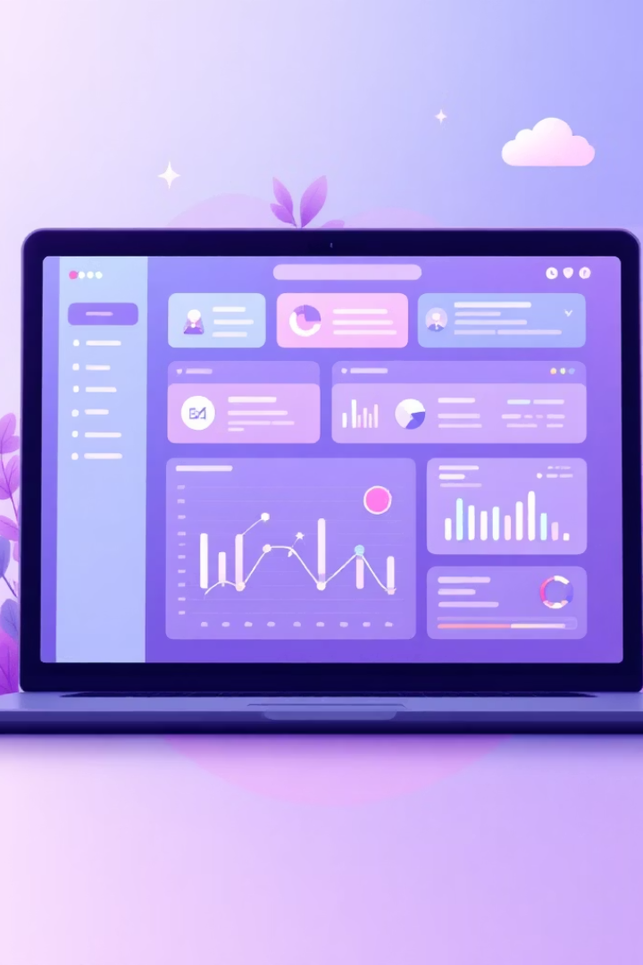
Application Demonstration
This section presents the real-time application of the system.
We showcase the user interface and its usability for maintenance tasks.
Notes:
Now that we have finished the second part, we will continue with the demonstration of the application.

Slide 7
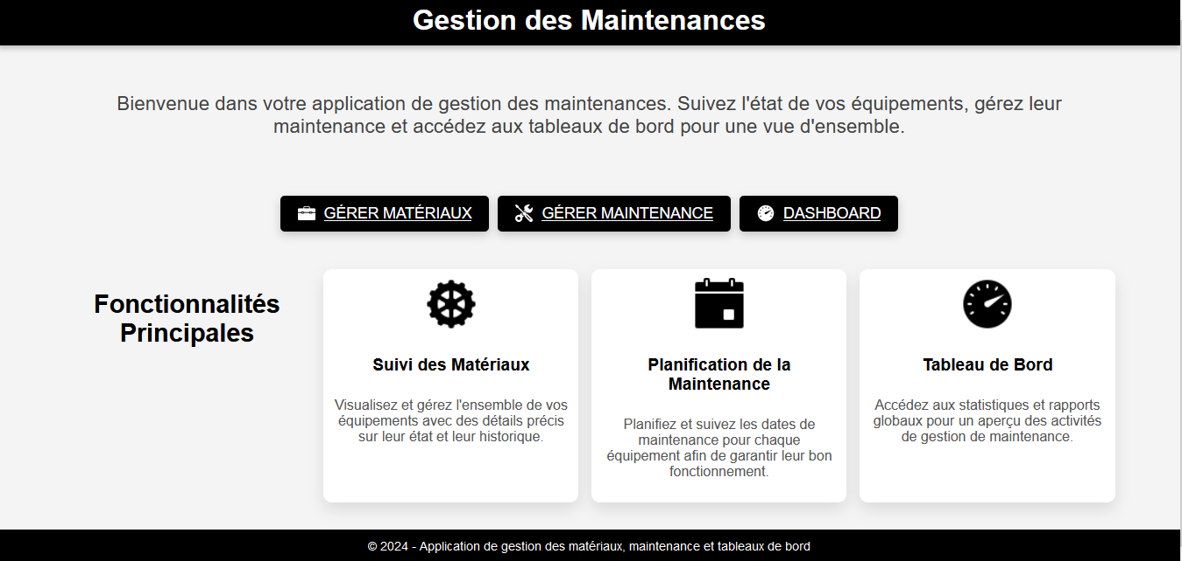
Notes:
Here is the application's home page. It includes links to the other pages, along with a description of what each page does.

Slide 8
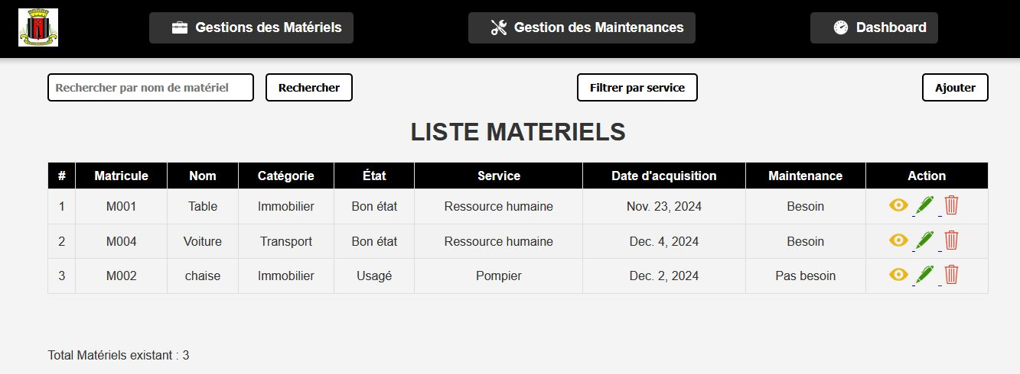
Notes:
After clicking on the first link, we arrive at this page: 'Equipment Management,' which contains all the equipment.

Slide 9
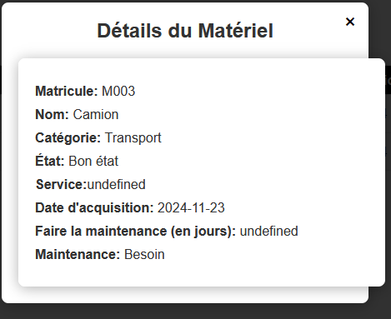
Notes:
After clicking on the eye-shaped icon, we get the details of the corresponding equipment

Slide 10
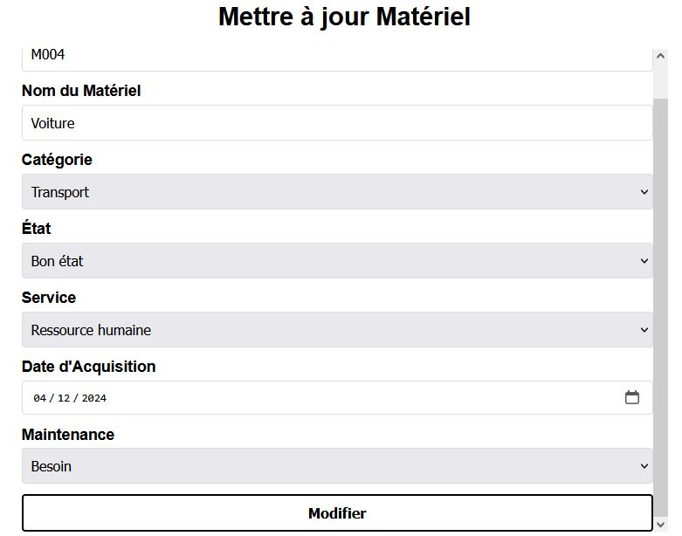
Notes:
Now, to edit a piece of equipment, you need to click on the pencil-shaped icon, make the desired changes, and when finished, click the 'Edit' button.

Slide 11
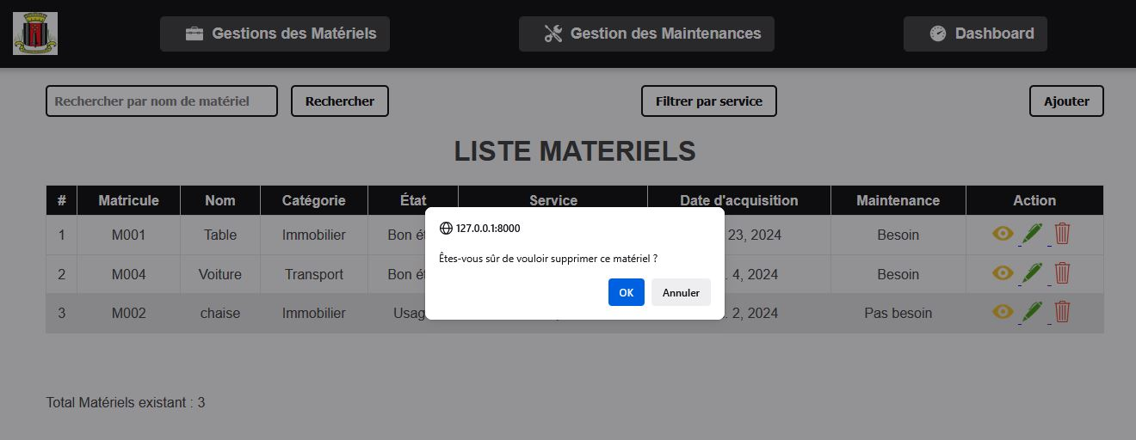
Notes:
To delete, click on the trash can icon, confirm, and the equipment will be deleted.

Slide 12
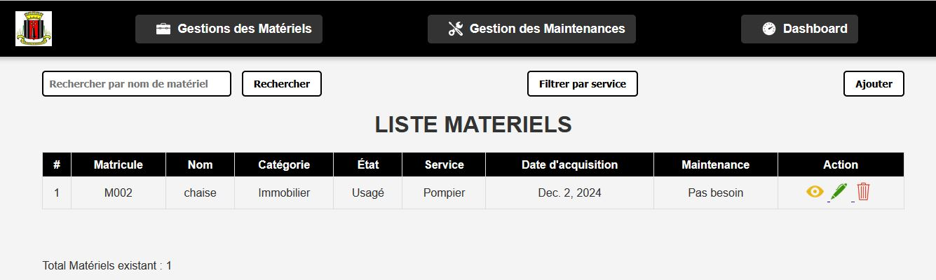
Notes:
We can also filter the equipment by department.

Slide 13
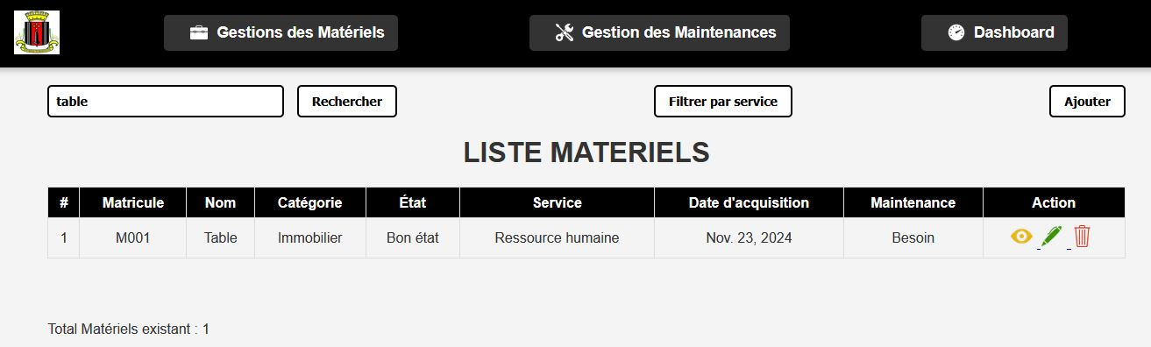
Notes:
We can also search for equipment by name; for example, here we are searching for all tables.

Slide 14
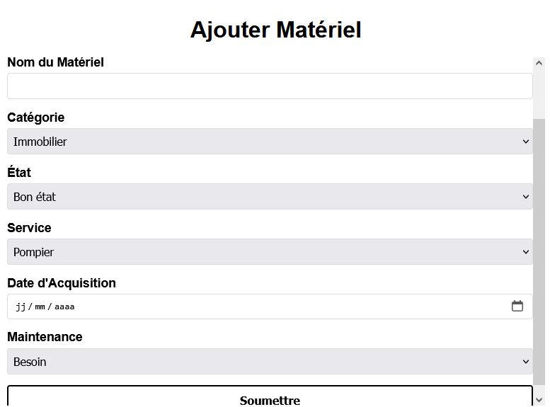
Notes:
To add a piece of equipment, click on the 'Add' button, fill out the form, then press the 'Submit' button.

Slide 15
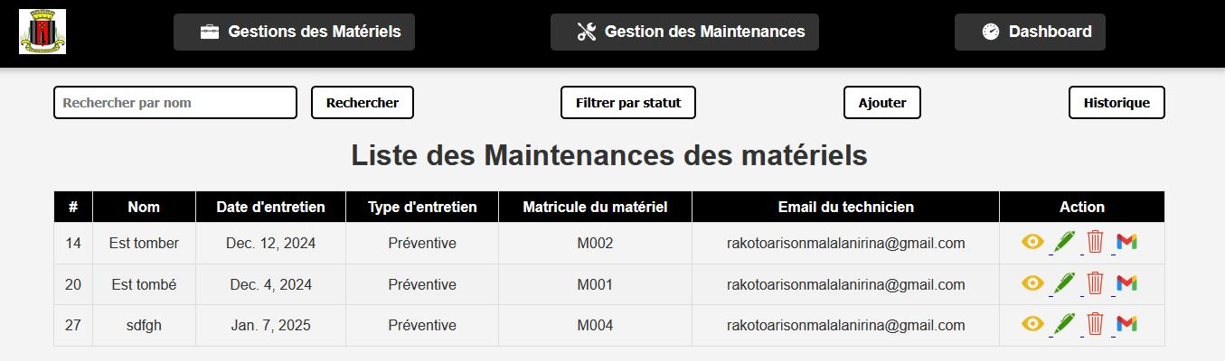
Notes:
Now, moving on to the maintenance management page. This page contains all the completed maintenance tasks. This page has the same features as the equipment management page, so we won’t show them again.

Slide 16
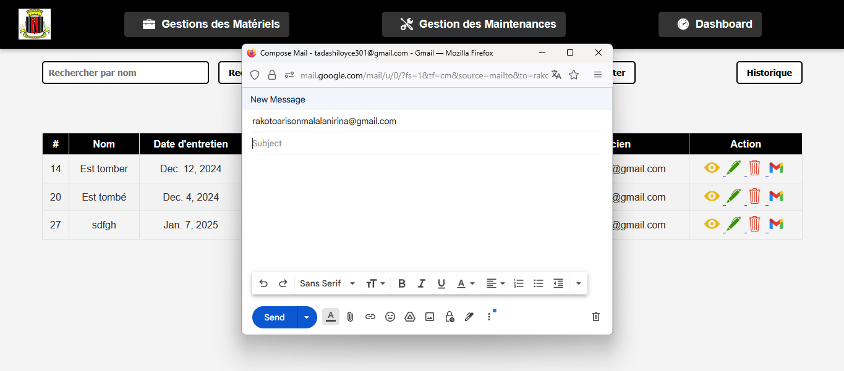
Notes:
By clicking on the email button, this email-sending window opens, and the email address for the corresponding row is already pre-filled. All you have to do is write the desired message.
We chose this approach instead of an automatic email system because it is much more flexible and practical. It allows us to use the email feature for different situations, such as informing the technician that a maintenance task has been canceled or rescheduled to an earlier date, and so on.

Slide 17
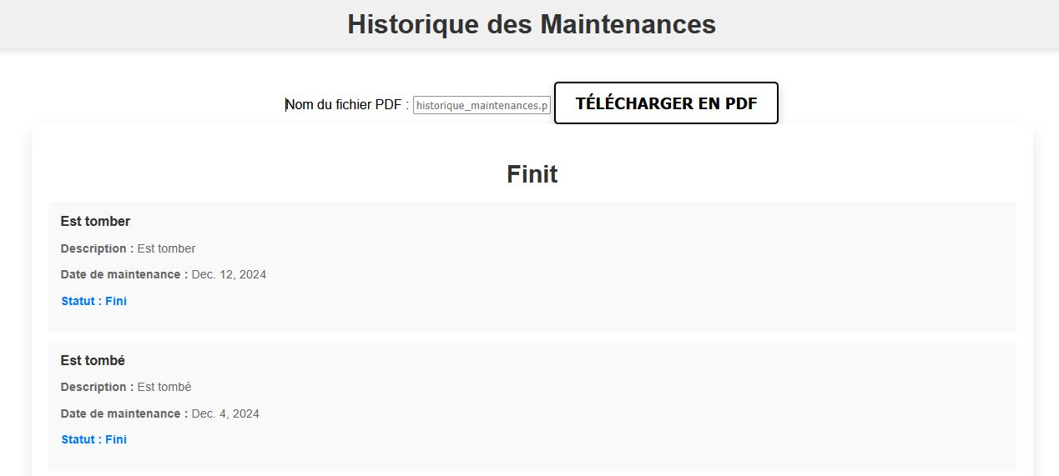
Notes:
Moving directly to the maintenance history. Here is the list of completed maintenance tasks for the equipment

Slide 18
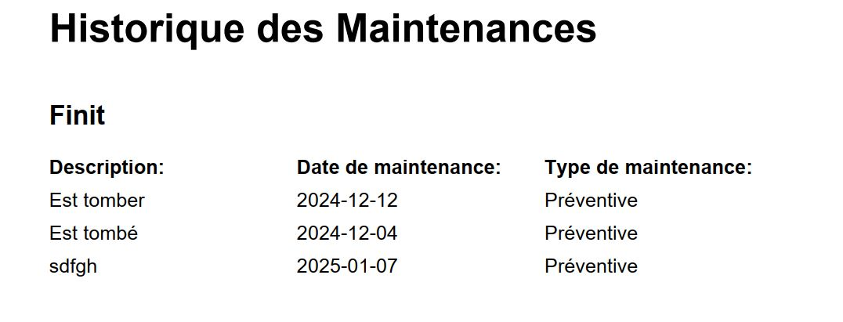
Notes:
And here is what the history looks like in PDF format for completed maintenance tasks

Slide 19
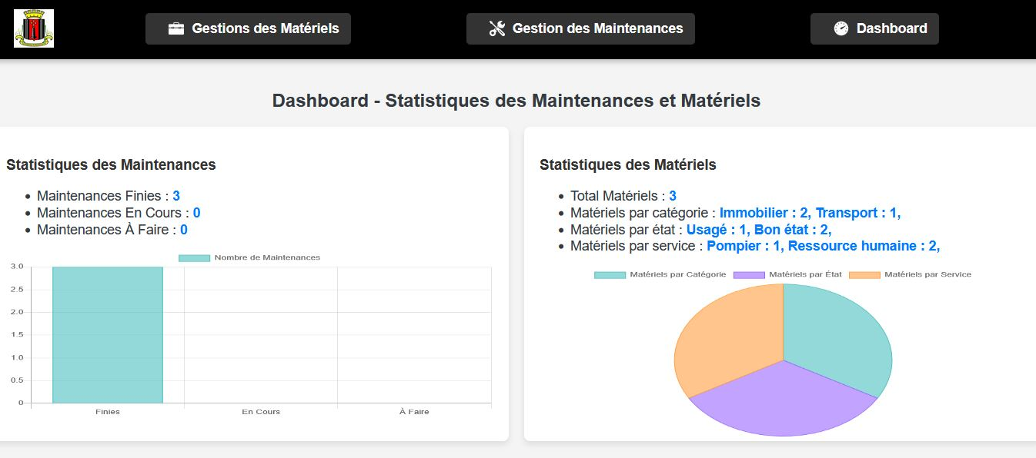
Notes:
Now, let's go to the dashboard page. On the left, we can see maintenance statistics by status — whether completed, in progress, or pending. On the right, we can see equipment statistics by category, condition, and department.

Slide 20
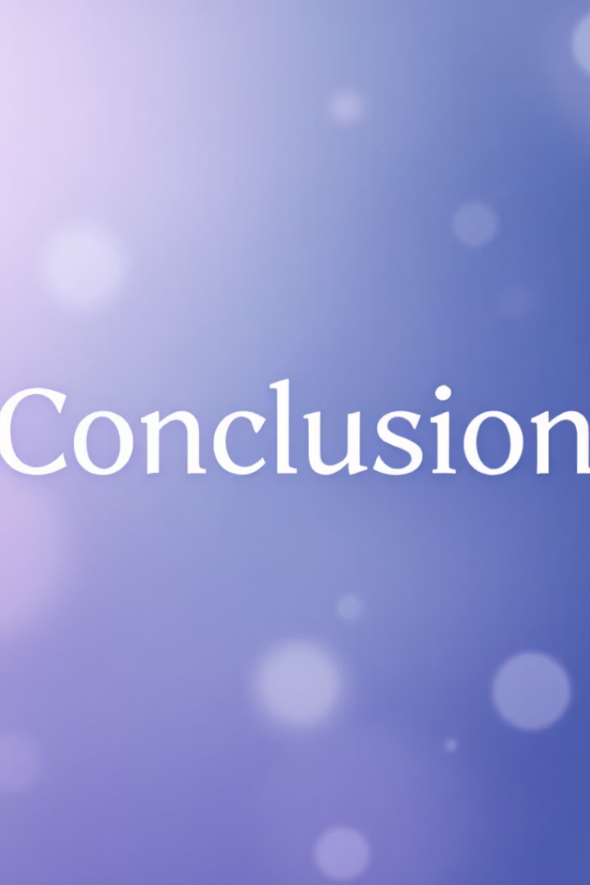
System Architecture and Workflow
The diagram depicts modules, data exchange, and user roles within the system.
It clarifies integration points and process sequences.
Notes:
To conclude, during the design and development of this application, all the features needed by the maintenance technician were added to eliminate manual work.

Slide 21

Conclusion and Appreciation
Thank you for your attention throughout this technical presentation.
We welcome your questions and insights for further improvement.
Notes:
So, I would like to thank you for listening until the end. I apologize for any mistakes I may have made during this presentation. I am now available to receive your feedback.

